Slide 1
Building A Portfolio
A Step-by-Step Guide for Completing a Portfolio for GIS Professional Certification
Contributions

Slide 2
The Certification Process
Requires submission of a professional portfolio and successful passing of the GISCI Geospatial Core Technical Knowledge Exam^{R}
The portfolio requires completion of all three components (education, experience, & contributions to the profession).

Slide 3

Your GISCI Portfolio: Contributions to the Profession

Slide 4

Helpful Tip
Before you Begin
There is no benefit to documenting a high point total. The point total is used only during application assessment and is not noted or reflected in your final certificate. It is unnecessary to expend extensive effort documenting minor achievements unless the point values are needed to meet the minimum.

Slide 5
The Contributions to the Profession Component
The Applicant will need a minimum of 8.0 ‘Contributions to the Profession’ Points to satisfy this section.
Extra contributions point can used for supplemental points.

Slide 6
The Contributions to the Profession Component
The minimum qualification for initial certification is to accrue points in areas that not only benefit the applicant but also benefit the profession as a whole.
It is expected that an active professional can attain a minimum of two Contributions points per year.

Slide 7
The Eight Categories of Contribution Points
GIS Publications
GIS Professional Association Involvement
GIS Conference Participation
GIS Workshop Instruction
GIS Conference Presentation
GIS Awards Received
GIS Volunteer Efforts
Other GIS Contributions

Slide 8
Notes on the Contributions to the Profession Component
Points should be included for each instance that the applicant has satisfied the listed contribution.
If the applicant has satisfied a contribution category more than once, the applicant may receive duplicate points.

Slide 9
Notes on the Contributions to the Profession Component
There is no limit to how many times a category may be used or how many points may be accrued in that category.
Not all categories need to be filled. If the candidate for example, has not published a book, they should move onto the next category.

Slide 10
Notes on the Contributions to the Profession Component
The applicant is not expected to document every single contribution point they earned during a 10 or 20-year career.
Documentation is not needed for any contribution of 2 points or less.

Slide 11
Notes on the Contributions to the Profession Component
There is no bonus for a point total that greatly exceeds the minimum.
If a discrepancy or misrepresentation of points is uncovered, the applicant runs the risk of being rejected. Efforts will be made by the GISCI to seek clarification first.

Slide 12
Notes on the Contributions to the Profession Component
Try to include points where adequate documentation is readily available.
Often the applicant may want to start with the most recent points earned and then work backwards until the point total is satisfied.

Slide 13
Work Related Contributions to the Profession
Work-related publications and sales presentations are elements of work experience and NOT contributions to the profession.
Contributions are intended to recognize documents and activities that relay lessons learned and techniques developed at work beyond the client and employer.

Slide 14
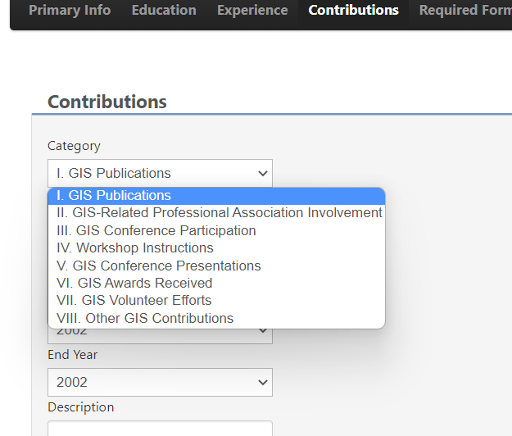
Completing the Contributions to the Profession Section
Locate the applicable contribution type on the Contribution Point Schedule.
Contribution claims of 2 points or less do not need documentation.

Slide 15
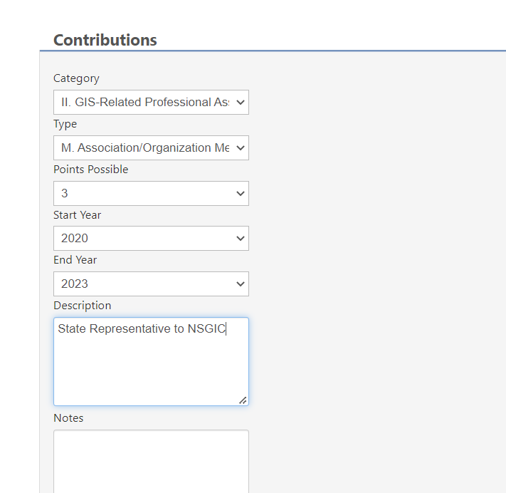
Completing the Contributions to the Profession Section
Select from the drop down to supply the necessary information.

Slide 16
Completing the Contributions to the Profession Section
Points are automatically calculated for an activity with a duration of more than one year (i.e., Association Membership). You do not need a separate entry for each year.

Slide 17
Documenting the Contributions to the Profession Component

Slide 18
Documenting Publications
Books/Published Atlas
The ISBN #, year, and title
Refereed Papers
The journal’s title, ISSN#, Volume and Number
Published Map
Location of where the map published and/or a copy of the credit.
Editorial Board
List the journal, publication, or serial, the ISSN#, years and capacity served
Article
Name of the publication in which it appeared, date, year, ISSN#, and a copy of the article
Paper in Conference Proceedings
Date and location of the conference, name of the conference, copy of the paper’s title page
Newsletter Article
Date and year of the article, Issue # or date, month, year, name of the newsletter, copy of the article or title

Slide 19

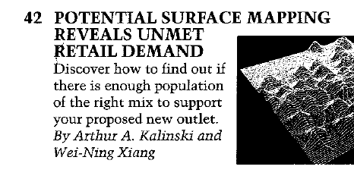
Documenting Publications Example
Provide sufficient documentation for all publication claims. Copies of articles are required.

Slide 20
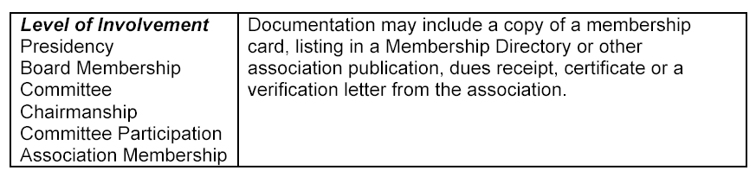
GIS Professional Association Involvement
This message is to confirm your service1998 on the Georgia URISA Board of Directors for four years:
2000 (Secretary)
2001 (Treasurer)
2002 (Treasurer)
2003 (Vice President)
Please let me know if you require additional information.
Regards.
Bruce Taylor
Georgia URISA President

Slide 21


GIS Conference Participation

Slide 22
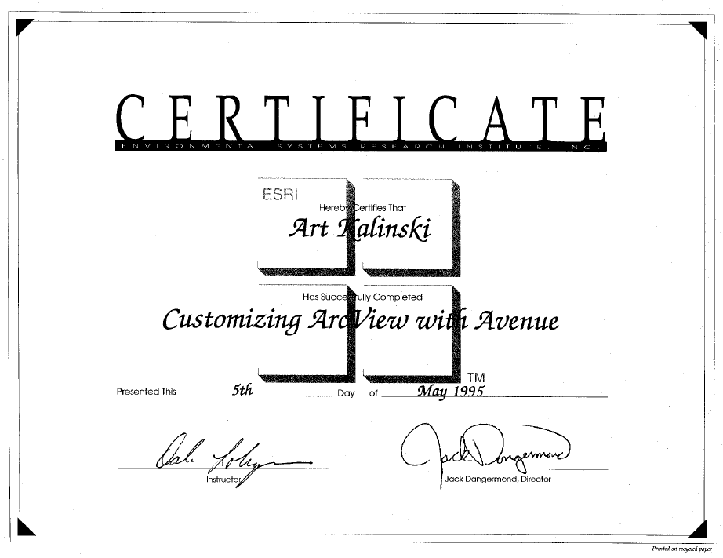
GIS Workshop Instruction
Documentation may include a copy of the certificate, listing in a conference program, or a letter from the sponsoring organization.
May 2008

Slide 23
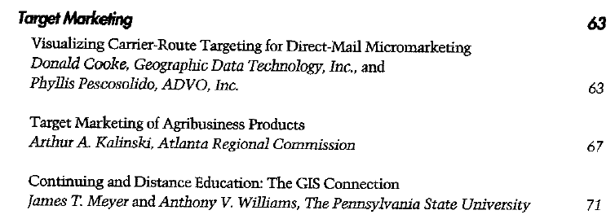
Conference Presentation/Poster
GIS in Business ‘08
Conference Proceedings
July 9-12, 2008
San Francisco
Hilton and Towers
San Francisco, California, USA
A copy of the relevant pages from the program or an acceptance letter from the organization sponsoring the event is acceptable documentation.

Slide 24
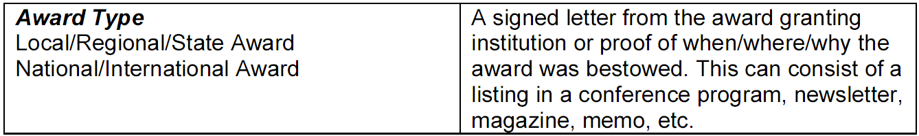
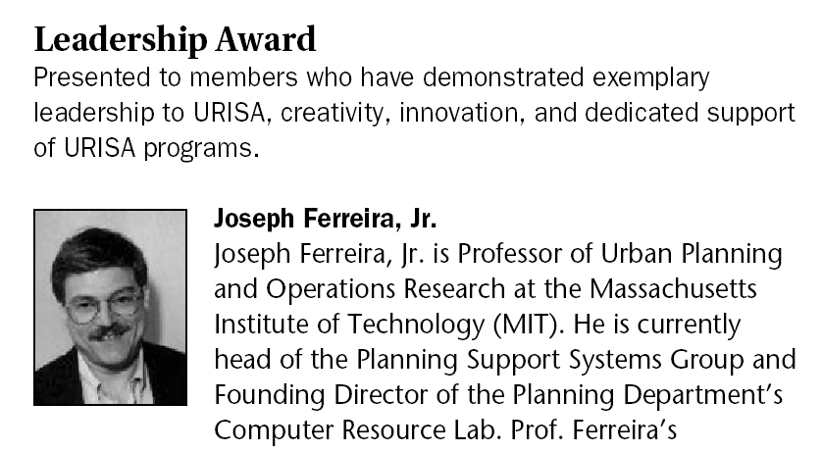
GIS Awards
Received

Slide 25

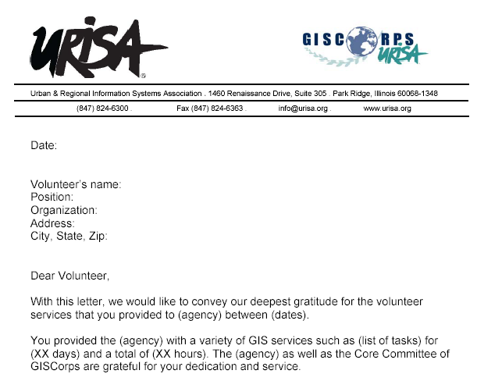
GIS Volunteer Efforts

Slide 26
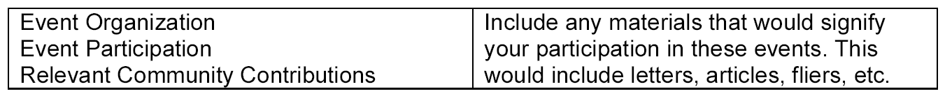
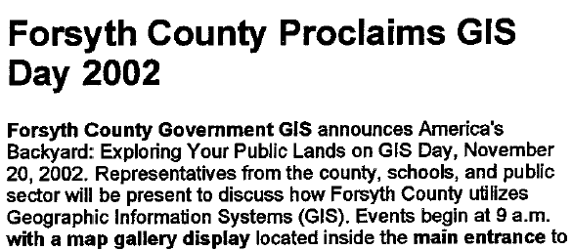
Other GIS
Contributions
Examples include GIS Day, Career Day, K-12, legislative initiative, etc. These must fall outside of the applicant’s professional responsibilities.

Slide 27
You have now completed the Contribution portion of the Portfolio
But you aren’t done yet! Continue with the other sections.

Slide 28
Any Questions?
Contact GISCI
www.gisci.org
Email: info@gisci.org
Phone 847-824-7768
Fax 847-824-6363

